Slide 1
Algorithm
Genetic Algorithm (GA)

Slide 2
Why GA?
Good solution qualities in reasonable computational times
Flexible – Objectives/costs can be redefined (not shown in this project)

Slide 3
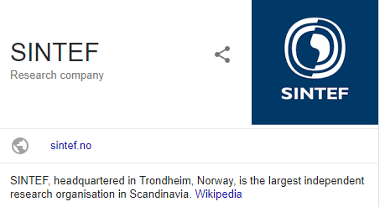
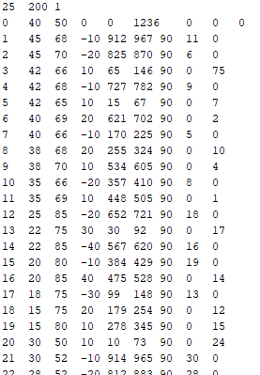
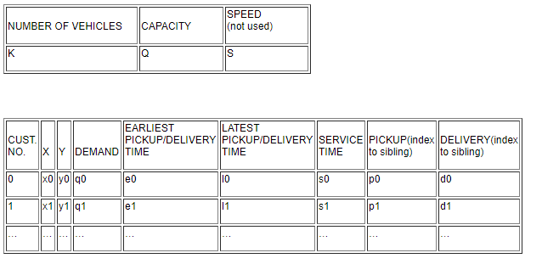
Li and Lim’s test instances

Slide 4
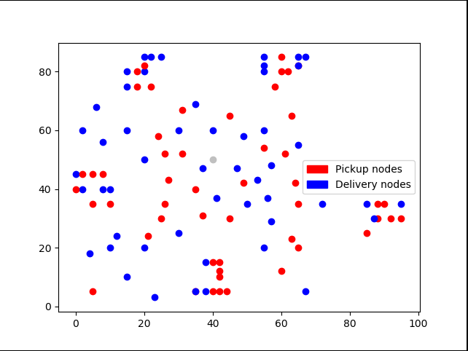
Li and Lim’s test instances

Slide 5
The Algorithm (single-depot instances)
(Mainly from) 2005, Giselher Pankratz, A Grouping Genetic Algorithm for the Pickup and Delivery Problem with Time Windows.
Grouping Genetic Algorithm(GGA)

Slide 6
Grouping Genetic Algorithm (GGA)
The solutions of the problems are encoded into individuals (chromosomes) represented by an array of genes. A gene represents information of a vehicle’s route.
request = a pair of an index pickup node and the corresponding index delivery node
{Requests} = A set of indices of requests.
[Route] = An array of a route (permutation of the indices of nodes)
Gene = [num, {Requests} , [Route] ]
Chromosome = [Gene1, Gene2, Gene3, ... ,Genev] ; v= the number of vehicle used (the number of routes)
Populations = An array of chromosomes

Slide 7
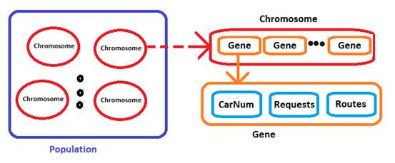
GGA – Structures image

Slide 8
GGA - Pseudocode
- Create feasible chromosomes
- Generation = 1
While not(termination criteria is met):
- evaluate_fitness(populations)
- sort_by_fitness(populations)
- remove 2 chromosomes with the worst fitness
- select the best 2 chromosomes, name them elite1, elite2. These 2 chromosomes will go to the next generation unchanged
- randomly select a pair of chromosomes, name them parent1 and parent2, remove them from the poplutions.
- child1,child2 <= crossOver(parent1,parent2,prob =1.0)
- child1,child2<=mutate(child1,prob=0.5),mutate(child2,prob=0.5)
- put child1,child2 back into the populations
- Generation <= Generation + 1

Slide 9
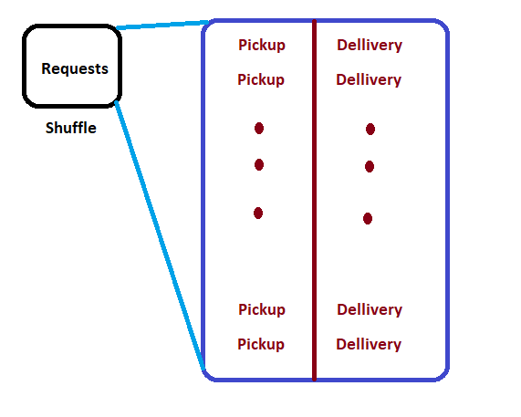
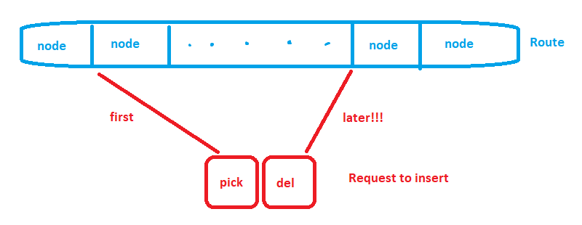
GGA – Inserting requests
Very important.
First, shuffle the requests to insert.
Then insert the requests into the route
one by one.
The pickup comes
Before the delivery.

Slide 10
GGA – Inserting requests (cont)
Check constraints after every inserting, discard the violators.
Try all combinations.
Choose the new route with the lowest costs.
Update gene(the vehicle) status(requests, the new route).

Slide 11
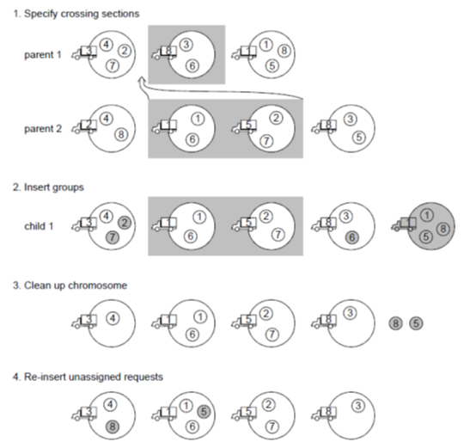
GGA - Crossover
(image from 2005, Giselher Pankratz, A Grouping Genetic Algorithm for the Pickup and Delivery Problem with Time Windows.)
First, we have the chromosomes parent1 and parent2. We randomly specify a crossing section on parent2.
Remove the duplicate vehicles on parent1 that also have on part from parent2. Insert the section into parent1, now parent1 became child1.
Remove the duplicate requests that already have on child1 and also have on the part from parent2 before the insertion.
Insert the remaining requests (according to previous slides)
Repeat the same processes on child2.

Slide 12
GGA - Mutate
Randomly select one gene (vehicle) in the chromosome.
Remove all requests and their corresponding route.
Insert the requests again to the chromosome.

Slide 13
Testing on Li and Lim’s instances
GA parameters
Generations : 3000, break if qualities of the best solutions in the populations are the same for 500 generations
Crossover rate = 1.0
Mutation rate = 0.5
Elitism (select the best 2 chromosomes and copy them unchanged to the next generation)

Slide 14
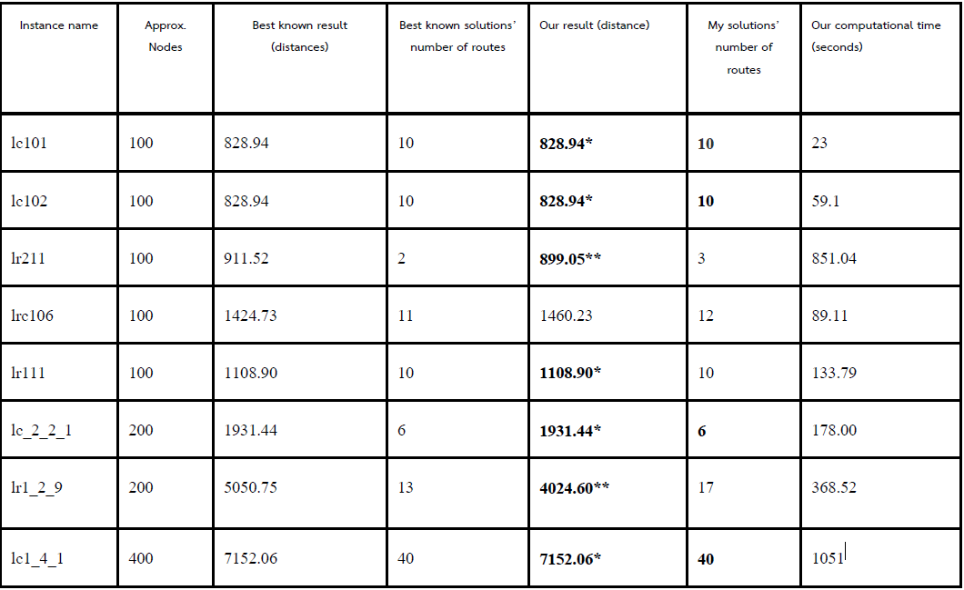
The results (Single depot)
(*) Results that equal to the the best known solutions
(**) Results that have less distances than best known solutions. Best known solutions try to minimize number of vehicles first, then try to minimize distances, that’s why my solution has less distances.

Slide 15
The algorithm worked pretty well
Let’s move on to the multi-depot
We are going to find the best way to assign the requests into the depots

Slide 16
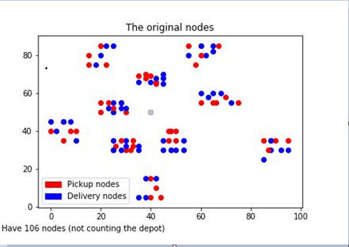
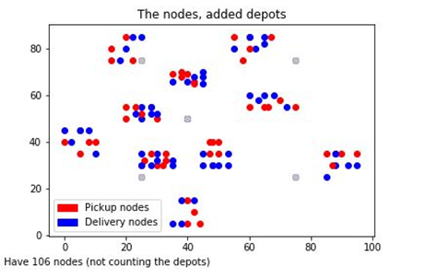
Modifying the Li and Lim’s instances

Slide 17
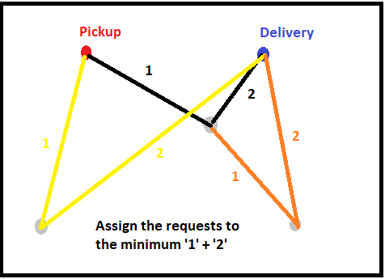
Ways to assign requests
1. Simple assign

Slide 18
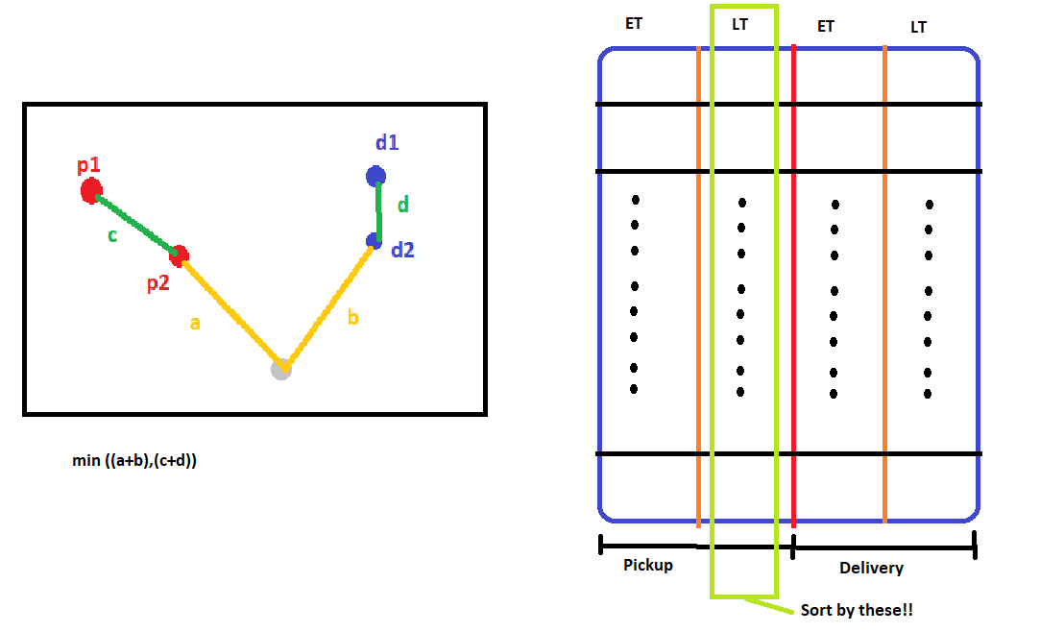
Ways to assign requests
2. Nearest Routable

Slide 19

Ways to assign requests
3. 3-Vote Nearest Routable
4. 3-Vote with condition

Slide 20
The results on multi-depot instances
Li and Lim’s instances number lc101-lc109,lc201-208,lr101-106,lrc101-105
Total 28 instances
Try assigning the requests to depots (4 ways)
Solve them as single-depot problems.

Slide 21
The results on multi-depot instances
Parameters for GA:
Population size = 100
Generations = 2000; break if the result is non-improving for 500 generations
Crossover rate = 1.0
Mutation rate = 0.5
Because of the random nature of GA, the tests were run 10 times and the results were calculated for the means(averages).

Slide 22
The results on multi-depot instances
Parameters for GA:
Population size = 100
Generations = 2000; break if the result is non-improving for 500 generations
Crossover rate = 1.0
Mutation rate = 0.5
Because of the random nature of GA, the tests were run 10 times and the results were calculated for the means(averages).

Slide 23
The results on modified multi-depot instances
Modified Li and Lim’s | AVG - simple distances | AVG Nearest Routable Distances | AVG 3-Voter Distances | AVG 3- vote with condition assigned Distances
Mean | 1060.606 | 1022.368 | 1005.78 | 1112.937
Average CT | 21.95579 | 29.30575 | 26.8124 | 43.41214
Solution Qualities :3-Voter nearest routable > nearest routable > simple > 3-voter with condition
Computational Times : simple(fastest) < 3-Voter nearest routable < nearest routable< 3-voter with condition (slowest)

Slide 24
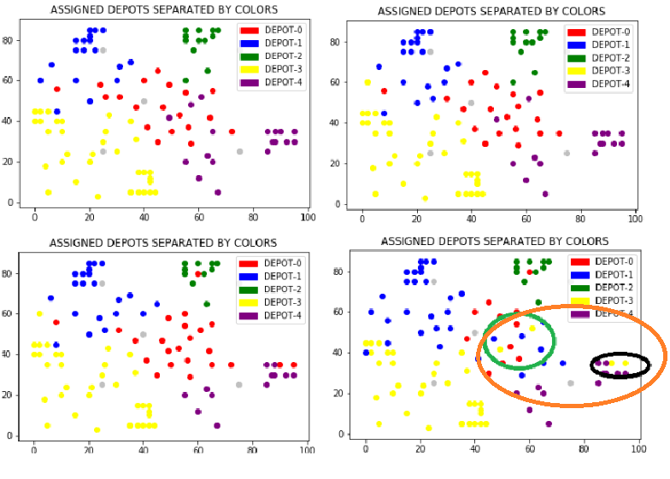
Sometimes the complicated ways give the bad solutions.

Slide 25
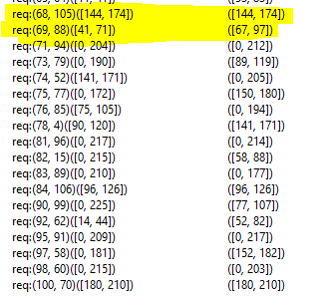
Li and Lim’s unusual time windows
Equals
Overlapped
No time constraints
But, we sorted by LT of pickups
Messing up the voters.

Slide 26
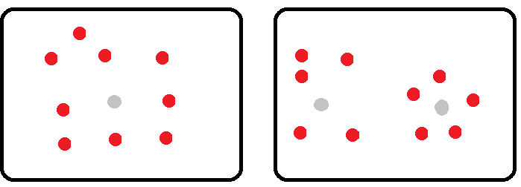
Remarks about the computational time
Solving one big problem is slower than many small problems
100 requests 1 depot SLOWER than solving 50 requests 2 depots.
Termination criteria, Inserting requests

Slide 27
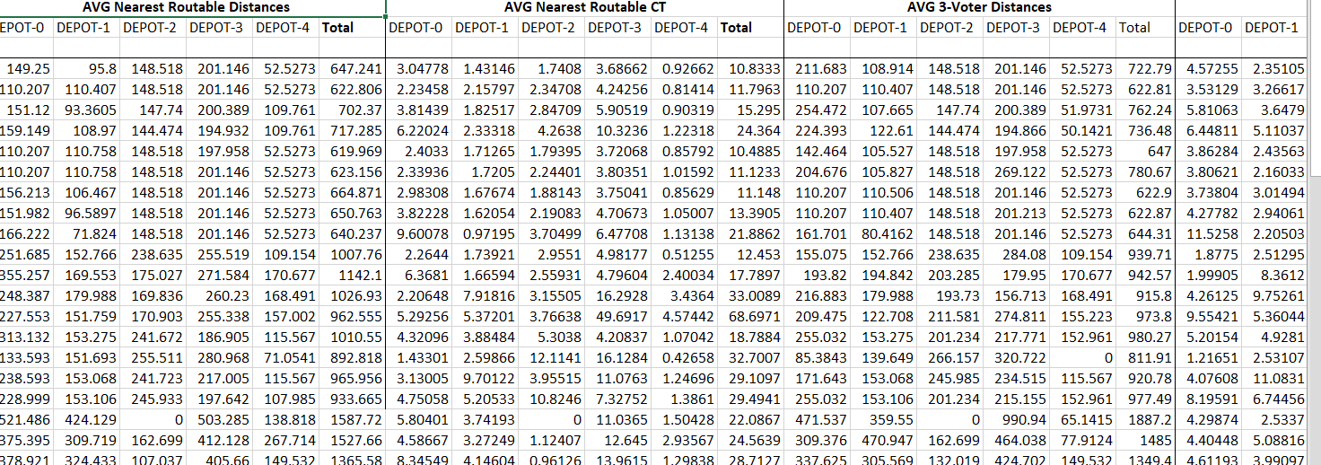
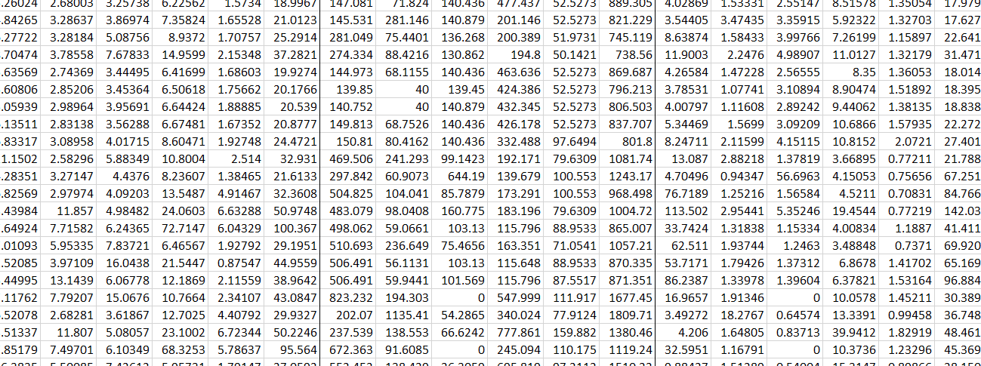
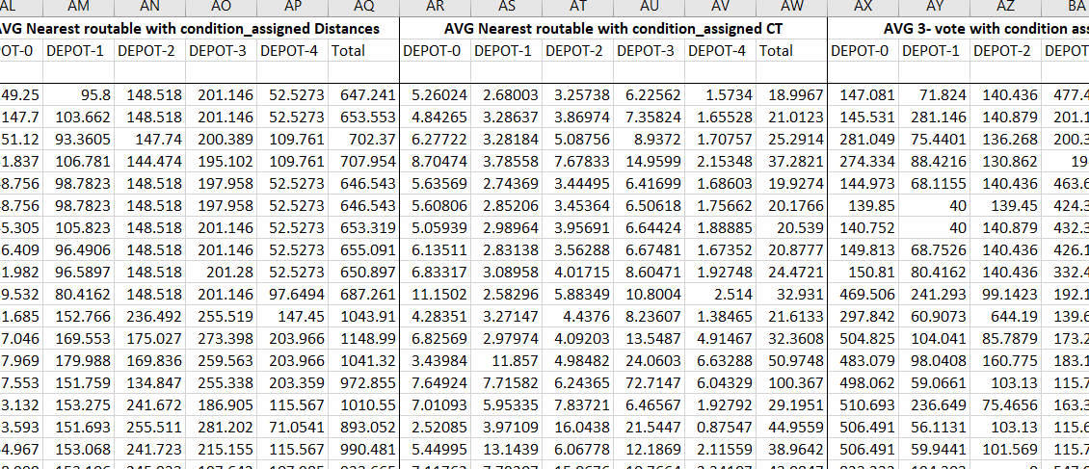
For more info., please read our reports!!

Slide 28

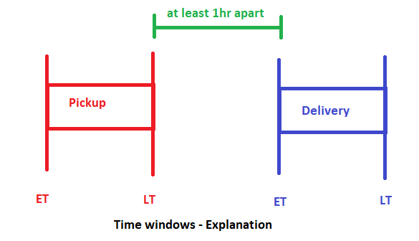
Let’s get real, The “GOO” instances!!
We created our own instances using real places in Bangkok.
Every instances has the same 80 locations, but the requests are randomly generated (40 pickups/40 deliveries)
The distances and durations between places were obtained from the GoogleMap API.
All vehicles have the same load capacities of 90, load demands are random from {10,20,30,40}
Time windows are randomly generated
(at least 1hr apart)
Service times = random (1sec – 15 min)
We create 12 instances (Goo1-Goo12)

Slide 29
The “GOO” instances – DEPOTS
Have 5 depots
1. BTS ChatuChak
2. Sanam-Pao
3. CentralRama9 MRT
4. Soi-SongPrha
5. BTS-Siam

Slide 30
The results – GOO instances
GOO | Naïve Worst Case (1 car per 1 request) | AVG simple Distances | AVG Nearest Routable's Distances | AVG 3-voter Distances | AVG 3-voter with condition assigned Distances
Mean | 655723.9167 | 372419.4 | 367569.3 | 359340.5 | 338231.6
CT | - | 35.54876248 | 38.6478667 | 46.41511585 | 73.89050641

Slide 31
Conclusions
There is NO single best way to deterministically assign the requests to depots.
The depots should be integrated into the chromosomes in GA.
At least, this is better than the naïve way.

Slide 32
Future Suggestions
The algorithms run substantially faster if implemented in another languages (C/C++, Java, etc.). Also, GA parameters can be improved (more generations).
Dynamic requests.
Really find the optimal solutions for the multi-depots. Integrate the depots into the chromosomes.
Multi-criteria.
More realistic constraints.
Real time, real traffic.

